Slide 1
Air Force Reserve Command Installations & Mission Support Program Overview
Mr Mike Klug
Chief, Facility Strategic Plans
15 Jul 2015
1
Notes:
1
A7P is overall POC for this briefing (same brief used for Annual Robins AFB Requirements Symposium in Nov and SAME Robins AFB Post brief in Jun)
Slide POC: A7PP
Updated: 26 May 13 (changed date)
Civil Engineer
Facilities (construction, maintenance & environmental)
Fire Emergency Services
Emergency management
Explosive Ordnance Disposal
Contracting
Security Forces
AT/FP
Physical Security & Police Services
Combat Arms

Slide 2
Overview
Who We Are and What We Do
What’s new at AFRC
Facilities Programs
Development
MILCON
FSRM
Where Do I Get More Info?
Notes:
The Defense Strategic Guidance states that, “Our Nation is at a moment of transition,” “a strategic turning point.” The United States must put its fiscal house in order, while the DoD & the Services reshape for the future.
Meeting the myriad strategic & fiscal opportunities & challenges requires leadership.
In A7 we are posturing for the future, whether it involves operating in anti-access environments or capitalizing on evolving resourcing dynamics.
During your visit with our great staff this morning, you will hear them describe some of these efforts.

Slide 3
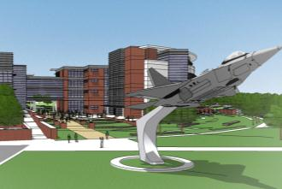
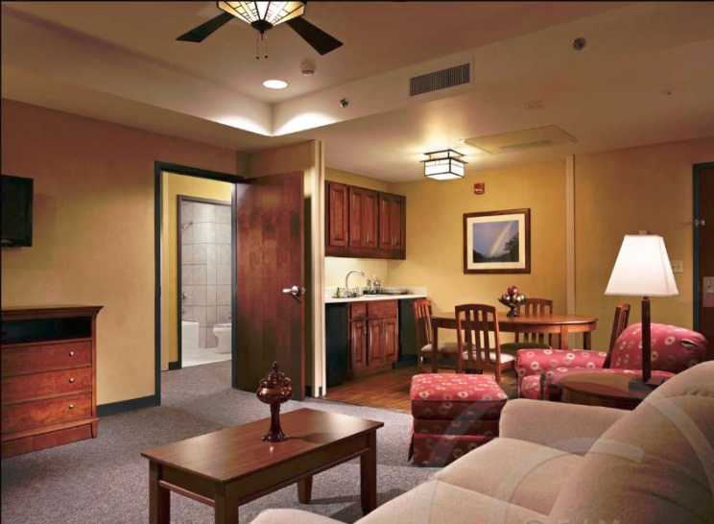
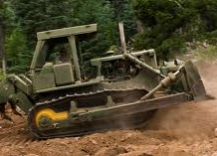
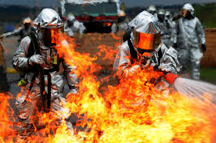
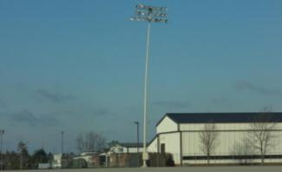
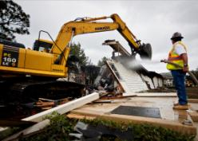
Civil Engineering
What We Do
Provide the training & combat installation platforms at home & abroad that enable Air Force global vigilance, reach & power & joint/coalition missions
Plan & Program
Acquire
Operate & Sustain
Protect
Recover
Divest
3
3
Notes:
3
3
The Total Force flies, fights & wins in Air Space & Cyberspace from installations.
Your A7 staff provide our command the capabilities to plan and program, acquire, operate, sustain, protect, recover & divest of CONUS, OCONUS & expeditionary platforms
Your A7 team provides direct support to weapons systems, personnel & on behalf of General Jackson manages a $6.4B physical plant that is comprised of nearly 3,000 facilities, 13 million square feet of building space (the equivalent of 2 Pentagons), 15 million yards of pavements & 21,000 acres or over 28 times the size of Reagan Washington National airport.
Photo Captions (from left to right 1st row then 2nd row)
Architectural Rendering of Phase 1 of AFRC Mission Complex demonstrating the planngn & programming tasks our staff performs
Interior Photo of Pittsburgh Lodging Interior demonstrating the acquisition of both the facility & furnishings
RED HORSE troops work on an environmental control unit at a deployed location
Senior Airman Christopher Dehart, a fire team member with the 302nd Security Forces Squadron, Peterson Air Force Base, Colo., takes aim with an M240B machine gun from the prone position. Dehart & his teammate each fired 1,300 rounds to qualify on the M240B during a recent unit training assembly at Airburst Range, Fort Carson, Colo. (Staff Sgt. Nathan Federico)
One of 8 damaged (leaning) stadium lighting pole on Grissom ARB airfield after November severe weather—estimated $200K-$500K to replace
Demolition of an excess facility

Slide 4
AFRC Footprint Host & Tenant Installations
Alaska
●
ARPC
Guam
4AF
22AF
HQ AFRC
Hawaii
10AF
9 Host installations – 57 Tenant Locations/Ranges
33 Flying Wings, 12 Flying Groups, 1 Space Wing Over 70K Citizen Airmen
$6.7B Plant Replacement Value, 21K Acres, ~3K Facilities
Notes:
Slide POC: A7PP, updated 31 May 2013
AFRC plant replacement value of $6.13B or 3.2% of AF PRV; nearly 1,200 buildings
Nine host installations PRV:$4.10B
Buildings: 13 Million Square Feet (Source: April 2013 Reserve Snapshot)
- About 2 Pentagons – 6,500,000 SF (Source: http://www.infoplease.com/spot/pentagon1.html)
Over 4 1/2 times Empire State Building’s 2,768,591 square feet (Source: http://www.mastersoftrivia.com/blog/2011/05/11-fascinating-facts-about-the-empire-state-building/)
Land: 21,000 Acres (Source: Mr David D’Amore, A7IA)
Equivalent to almost 42 Disneylands (source: http://corporate.disney.go.com/)
Over 19 Perry Agricenters in acreage (source: http://www.gnfa.com/)
Airfield Pavement: 15M Square Yards (Source: April 2013 Reserve Snapshot)
-Equivalent to 4.8 square miles of concrete
Locations: 66 where AFRC has real estate interest
• 5 Air Reserve Bases (Dobbins ARB, Grissom ARB, Homestead ARB, March ARB, Westover ARB)
• 4 Air Reserve Stations (Minn-St Paul IAP ARS, Niagara Falls IAP ARS, Pittsburgh IAP ARS and Youngstown-Warren ARS)
• 3 Navy Tenant Locations (Carswell, JB Pearl Harbor-Hickam, & JB Guam-Andersen)
• 4 Army Tenant Locations (Pope, Ft Sill/Falcon Range, Ft Wolters & JB Lewis McChord)
• 1 ANG Tenant Location (Portland)
• 42 AF Tenant Locations
• 3 Miscellaneous Locations (Minn St. Paul O’Club Annex MN, Rosecrans Memorial Airport MO, and Starvaggi Training Site PA)
• 4 Ranges (Claiborne LA, Clinton PA, Snelling MN, and Consol OH)
Slide POC: A7PP
Updated: 31 May 13 – updated based on data in AFRC Snapshot – Jun 2013
From an operational perspective, the Air Force Reserve Command is one of ten MAJCOMs, and is the largest personnel-wise with nearly 75K people (source: AFR Snapshot, June 2013):
Traditional 48,618; ART—10,400; IMA—8,974; AGR—2,888; Civilian—4,024

Slide 5
What’s New at AFRC?
A7
Installations & Mission Support
A4
Logistics
A4
Logistics, Engineering and Force Protection
A4L
A4M
A4C
A4S
A4P
Logistics
Material Mgt
Force Mgt
Aircraft MX
MX Support
MX Mgt
Facility Ops
Program Dev
Program Mgt
Readiness
Emergency Svc
Asset Mgt
SF Operations
SF Resources
Installation POM
Logistics POM
Systems Integration
Notes:
Gen Jackson provided the 7 A7 focus areas listed on this slide.
Clearly our Nation & our Air Force face tough challenges that require disciplined use of dwindling resources while still remaining resilient, agile, flexible & ready.
In A7 we recognize that we must not only adapt to a changing strategic & fiscal landscape, but also lead the change, while remaining focused on providing ready & effective ACS for both expeditionary & garrison environments.
Therefore, your A7 staff are focused on continually improving the delivery of effective & efficient installation support for the AF & Joint team.
Our 23,000 ACS professionals train to the same high standards as the Active Component, & are invaluable assets towards meeting the AF’s many & varied commitments as demonstrated by the nearly 200 A7 civil engineers, security forces & contracting Airmen currently deployed to Afghanistan, Kyrgystan, Oman, Qatar, Saudi Arabia & other locations
Further AF centralization of Installation and Mission Support
USAF Common Output Level Standards (AF COLS)
Public-Public & Public-Private Partnerships (P4)

Slide 6
What’s New at AFRC?
A7
Installations & Mission Support
A4
Logistics
A4
Logistics, Engineering and Force Protection
A4L
A4M
A4C
A4S
A4P
Logistics
Material Mgt
Force Mgt
Aircraft MX
MX Support
MX Mgt
Facility Ops
Program Dev
Program Mgt
Readiness
Emergency Svc
Asset Mgt
SF Operations
SF Resources
Installation POM
Logistics POM
Systems Integration
Notes:
Gen Jackson provided the 7 A7 focus areas listed on this slide.
Clearly our Nation & our Air Force face tough challenges that require disciplined use of dwindling resources while still remaining resilient, agile, flexible & ready.
In A7 we recognize that we must not only adapt to a changing strategic & fiscal landscape, but also lead the change, while remaining focused on providing ready & effective ACS for both expeditionary & garrison environments.
Therefore, your A7 staff are focused on continually improving the delivery of effective & efficient installation support for the AF & Joint team.
Our 23,000 ACS professionals train to the same high standards as the Active Component, & are invaluable assets towards meeting the AF’s many & varied commitments as demonstrated by the nearly 200 A7 civil engineers, security forces & contracting Airmen currently deployed to Afghanistan, Kyrgystan, Oman, Qatar, Saudi Arabia & other locations
Further AF centralization of Installation and Mission Support
USAF Common Output Level Standards (AF COLS)
Public-Public & Public-Private Partnerships (P4)

Slide 7
A4C Civil Engineering
Who We Are & What We Do
A4
Logistics, Engineering and Force Protection
A4L
A4M
A4C
A4S
A4P
A4CO
A4CD
A4CM
A4CX
A4CE
A4CA
AFRC Facility Operations
CE Service Contracts
Engineering SMEs
Energy / Utilities
Infrastructure Plans
Facility project planning & programming
FOCUS
MILCON/P-341 &
O&M programming
Community Planning
Strategic Basing
Site Surveys/SATAFs
Facility project design & execution
MILCON/P-341 &
O&M design
MILCON/P-341 &
O&M construction Mgt
Organize, Train & Equip Civil Engineer Forces
CE Force Posture & Skills Training
Prime BEEF
RED HORSE
Emergency Services
Explosive Ordnance Disposal
Emergency Management
Fire Emergency Services
Asset Management
Asset Mgmt Plans
Environmental Services
Real Estate/Property
Notes:
In A7, we have a small front office with 6 subordinate divisions

Slide 8
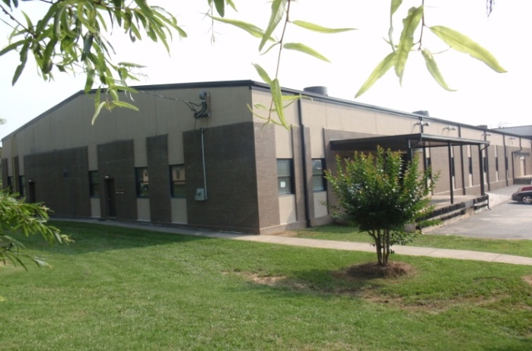
Facility Project Circle of Life
Requirement - Unit
IDP / ADP
FOCUS
Emergent Needs
Execute
Program - BCE
Local contracting
Corps of Engineers
AFCEC
AF Form 332
DD Form 1391
MSG/CC
Sanity Check
Prioritize
- Wg Facilities Board
- AFRC Corporate Structure
Fund
Annual program calls
CE/CONS execution strategy
NAF coordination (MILCON)
O&M – request when ready
MILCON – annual appropriation
Host: you own the process; take care of tenants
Tenant: make needs known; BCE is your entry point
Plan, prioritize, and pursue – get high impact projects ready to execute
Notes:
OPR: A7PD
Updated: 19 Mar 15: FOCUS updates every 5 years now based upon 2 complete rounds of FOCUS visits, reduce costs, and deliver reports faster. Typically, complete 5-6 bases per year beginning in FY15.

Slide 9
Installation Planning
Base | IDP Status (ECD) | AICUZ Status
Dobbins | Jun 15 | 2011 - Complete
Grissom | Sep 15 | 2014 - Complete
Homestead | Oct 15 | ECD Oct 15
March | Dec 15 | 2005 – Complete (update pending)
Minneapolis | Jul 15 | N/A
Niagara | Aug 15 | 2015 - Complete
Pittsburgh | Jul 15 | N/A
Westover | Jun 15 | 2012 - Complete
Youngstown | Aug 15 | N/A
IDP documents 20-30 year installation development vision
ADP provides details for specific mission areas
(tenants)
Products maintained on AFRC SharePoint site to facilitate Installation Facility Boards requirements
On-Site expertise provided to AFRC Installations and Tenants as available
Take-away
Objective: All AFRC Bases and Stations compliant by the end of Dec 15
Measure: Installation Development Plans(IDP) completed in accordance with AFI 32-7062
Data Source: Program Management Plan and base-reported data
Make sure IDP reflects your priorities
Stick to the plan as much as possible!
Installation planning is cornerstone to long-term program success
3 Mar 14
AFRC/A7PP
Notes:
OPR: A7PP

Slide 10
FOCUS Background
FY07 initiative to evaluate facility use & facility condition at all AFRC operation locations
Implement consistent standards
Quantify true facility funding needs
5 Year Cycle
1st Round, FY08-11 effort surveyed 47 locations
2nd Round, FY12-15 plan to survey 33 locations
Added BUILDER / S-File data
Challenges
Right-size units & comply with AF 20/20 by 2020 goal
Develop executable plans (O&M vs. MILCON)
Consider changing force structure
Identify ALL facility requirements
Utilities, Pavements, Energy, etc.
Standardized, enterprise-wide facility assessment
Notes:
OPR: A7PP
Updated 18 Mar 15
The Focus program began in FY07 as an A7 initiative to put the same set of eyes on all the AFRC facilities at all of the AFRC operating locations.
The intent was to ensure that we were maintaining our facilities to the same standard and to ensure that proper space was available for all organizations. In doing so, we are able to capture our true facility funding needs.
We started the effort back in FY08 on a 4 year cycle in which we visited 46 locations. We are currently in the last year of our second 4 year cycle in which we are visiting 33 locations.
As we visit the different locations and reassess the units, some of the challenges that we are having to deal with include: trying to right-size the units and still comply with the AF 20/20 by 2020 goal and minimizing the use of MILCON funds. In addition, pending force structure changes at many locations make future facility planning difficult.
Current Contractor = J. M. Waller/Versar – San Antonio office, Project leads are retired AF
Avg Cost Round 1 = $3.2M yr (11 locations & assessing 3.2M NSF or 4.3M GSF per year)
Avg Cost Round 2 = $4.2M yr (8 locations & assessing 3.1M NSF or 4.2 GSF per year)
Cost increase due to BUILDER data collection being accomplished in Round 2
Total Assessed 1st Round - 13.0M NSF / 17.4 GSF
Total Assessed 2nd Round – 12.3M NSF / 16.9 GSF

Slide 11
AFRC MILCON Project Funding
FY17 spike is KC-46 beddown wedge
No current mission projects in FY17-18
Limited P341 used for force structure out-of-cycle change
Louisville COE District is lead for AFRC programs
$M
Countermeasure
All numbers are programmed amounts & include P&D & P341 funds
Continue mission critical, worst first investment focus
Ensure every dollar counts
Objective: Recapitalize AFRC facilities for mission critical requirements
Measures: Program funding vs. $100M requirement to buy down $1B
backlog
Data Source: President’s Budgets
Reduced MILCON funding levels puts additional pressure on O&M FSRM Program
30 Nov 13
A7PP
Notes:
OPR: A7PP
Updated 18 Mar 15: Changed validated MILCON backlog from $1.4B to $1B (~$400M in lodging projects removed).
AFRC FOCUS program has validated $1B in AFRC MILCON requirements. The AF MILCON program is very limited. AFRC has established $100M as a reasonable level of execution per year to buy-down the MILCON backlog over an approximately 10 year period. FOCUS now concentrating on O&M solutions to fix condition/space deficiencies
Out-year fund line drives pressure for O&M solutions, hurts new mission chances
Average MILCON program over last 22 years = $41.49M ($26.413M without inserts)
Highest funding years were 2010 ($107.6M—largest in AFR history), 2005 ($100.9M), & 2006 ($95.687M)
Lowest funding years were 2011 ($3.413M), 1991 ($3.85M), & 2013 ($6.1M)
FY13 is third lowest MILCON program funding in the last 22 years. In FY13, strategic pause in AF MILCON due to Force Structure Announcement; AF program limited to Corporate initiatives & New Mission MILCON, using $900M+ for higher priority bills.
Congress added $83M to AFR request in FY10; no Congressional inserts or adds since
FY11-13 AFR MILCON funding was short $62.9M vice 3.8% MILCON equity (in past rounded up to 4%)—most severely underfunded 3 year stretch in last 22 years
FY11 received 0.6% of $1.2836B AF TOA vice 3.8% equity (3.2% short = $40.9M)
FY12 received 2.4% of $1.3769B AF TOA vice 3.8% equity (1.4% short = $18.7M)
FY13 received 2.9% of $375.9M AF TOA vice 3.8% equity (0.9% short = $3.3M)
========================
FY10 MILCON Auth/Approp 15 projs, $107.6M awarded (Largest in AFRC history)
FY11 MILCON Auth/Approp 1 Proj, $7.8M – 1 proj @ Patrick AFB Munitions Maintenance Facility)
FY12 MILCON Auth/Approp (March ATC Tower/Base Ops $16.4M; Charleston RED HORSE Training $9.6M)
FY13 PB MILCON Auth/Approp ($6.1M for Niagara C130 Simulator)
FY14 PB MILCON Auth/Approp
March Deployment Processing Center, $19.9M
Tinker Air Control Group, $12.2M
Homestead Entry Control Gate, $9.8M
FY15 PB MILCON Auth/Approp
Robins Consolidated Mission Complex Ph 1, $27.7M
Seymour Johnson Tanker Parking Apron Expansion, $9.8M
NAS Ft Worth EOD Facility, $3.7M

Slide 12
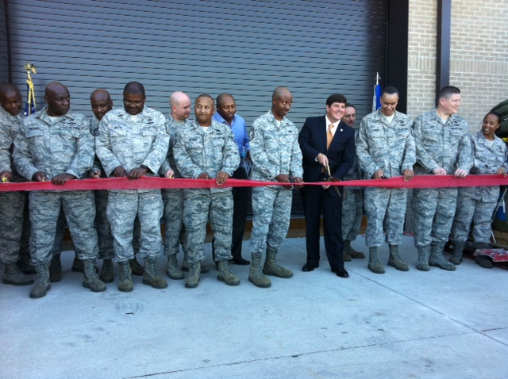
AFRC Facilities Program Future MILCON Projects
40 “top tier” Projects
$376.3M Current Mission
Host & Tenant locations
Representative Projects Range $5M - $40M
Ensuring our Installations are Ready, Capable & Viable
Notes:
Slide POC: A7PP
Updated: 31 May 13 – Source: AFRC/CC Approved FY15 MILCON IPL
Our facility investment strategy focuses on right-sizing, sustaining & recapitalizing our installation power projection & training platforms
1 Robins GA HQ AFRC Phase 1
2 Seymour J. NC Tanker Parking Apron Expansion
3 Davis M. AZ Guardian Angel Operations
4 Dobbins GA Fire Station / Security Complex
5 Westover MA C-5 Aircraft Maintenance Shop Facility
6 Carswell TX Add Simulator Bay, Building 1792
7 Keesler MS Aeromedical Staging Squadron
8 Lackland TX Consolidate 433 Medical Facility
9 Homestead FL Add Simulator Training Facility, B191
10 Homestead FL Live Ordnance Load Area
11 Youngstown OH Firing Range
12 Dobbins GA Fitness Center Facility
13 Westover MA AF Regional ISO Maintenance Hangar
14 Whiteman MO Munitions Trailer Maintenance Facility
15 Grissom IN Aircraft Maintenance Hangar (Nose Dock 5)
16 Robins GA Consolidate HQ AFRC Phase 2
17 Hill UT Reserve Medical Training Facility
18 Anderson GU ASTF Facility Addition
19 Maxwell AL Aircraft Parking Ramp
20 Pittsburgh PA Wing Headquarters

Slide 13
AFRC O&M FSRM History
Bought out executable FY14 requirements
10 yr obs avg: $143M/yr
$200M FY15 FSRM IPL approved 6 Oct
Budget cuts drive IPL importance and discipline
MILCON reductions put pressure on O&M FSRM
FOCUS validated $1B backlog
$M
Objective: Recapitalize AFRC facilities to meet critical mission requirements
Measures: Program funding vs. $200M backlog-based requirement and 2% PRV investment (Recap MILCON + all FSRM) floor
Data Source: Execution, FY15 PB
Countermeasure
Continue “worst-first” AFRC Corp. Structure approved strategy
Facility commitment reflects mission commitment
10 Aug 12
A7PD
Notes:
OPR: A7PM
OCR: A7PP
Updated18 Mar 15: Changed R&M PB/POM from $20M/yr to $40M/yr. Changed FOCUS validated backlog from $1.36B to $1B due to removing “new footprint” lodging from backlog as 2014 lodging policy is to freeze the footprint.
This is a great news story that offsets the stress in the MILCON program. As you can see from the graph, the last four years AFRC has made significant investments in facilities. In light of that, we plan to prepare $200M of requirements to be ready to execute as funding becomes available. What you also see, however, is that the FSRM program has been a year of execution bill as shown by the small light green bars representing the PBs and blue bars the POM. We’ve invested nearly $900M( actually $875.4) in the last five years, and that seems like a lot of money, but that funding needs to make buildings last 50-70 years or more.
FSRM O&M Historical Submissions, Execution, and % Sustainment
For FY11 wings submitted 334 projects worth $305M
For FY12 wings submitted 554 projects worth $354M
For FY13 wings submitted 467 projects worth $272M
For FY14 wings submitted 491 projects worth $342M
In FY15 wings submitted 439 projects worth $301M
5-yr avg: wings submit 457 projs/yr worth $315M ranging from $5K to $15M

Slide 14
FY14 FSRM Vs Historical Funding
FSRM Funding By Category
FSRM Host Vs Tenant Funding
FOCUS helps identify
Tenant requirements
Historical FSRM Quarterly Funding
Assessment
Airfields in good shape, continued emphasis on infrastructure, renovations, and design
Tenant proportion trend stabilizing at ~ 60/40 split host-to-tenant investments (vice 70/30 PRV ratio) due to FOCUS visits
FY14 uncertainty pushed obligations to right
FY15 goal: pull obligations to left
FM/CE/CONS team enables early execution
FY15 Goals: pull obligations to left; focus on top IPL priorities
Notes:
OPR: A7PD
as of 9 Oct 14
Historical Obs:
This chart shows the past three year’s of funding distribution throughout a “typical” year. Although hard to predict when funds will become available it is clear the majority of funding always comes in the last quarter. This is due to programs unable to execute funding for various reasons are migrated into FSRM to fund critical command facility project requirements serving every functional field and capability. Last year was a great year as FM was able to push funds early in the year that enabled year round execution, spreading workload on CE, comptrollers, and contracting. For FY15, as in past years, we’ll team with FM to navigate through CRA to appropriation.
Host Vs Tenant Funding
Our Host vs Tenant unit funding profiles shown here indicate a trend in more funding shifting to our tenant units to address previously unhighlighted facility requirements now identified by our FOCUS team visits and TFI requirements. This ensures all our people are being taken care of and their missions maximized to increase AFRC Force Readiness across the board. We are seeing this leveling out at about a 60/40 split, host to tenant, vice a 70/30 split for PRV primarily due to TFI and FOCUS.
Funding by Category: This profile is very typical to FY facility investment
Energy Projects: continue to grow our energy program to help meet mandated energy reduction goals.
Quality of Life: gyms, dining facilities, community centers.
Mission support: TFIs, facility renovations, AT/FP requirements
Design: building the program for FY15 execution
Demo: continuing to push for footprint reduction and save funding by demolishing energy hogs, reduced sustainment

Slide 15
Where Do I Get More Info?
Request for Information (RFI)
Sources Sought Synopsis
Pre-solicitation Notices
Award Notices
Requests for Quotes/Proposals
Government-wide Point of Entry (GPE)
http://www/fedbizopps.gov
http://www.ebuy.gsa.gov
AF Budgets – current and historical
http://www.saffm.hq.af.mil/budget/index/asp
Notes:
Slide POC: A7K
Updated: 11 Jun 13. No change except POC from A7PM to A7K
All requirements subject to public notice that exceed $25K are advertised in FedBizOpps or GSA Ebuy. This includes supplies, services, and construction.
Other Links
AFCEC
HQ AFRC/A7
SAME National
SAME Robins Post
Events coming
2014 SAME SE Regional JETS, 24-26 Jun, Savanna
SAME/DBIA Fed Proj Delivery Symposium - August 19-21, DC
DBIA Conference & Expo October 6-8, Dallas
SAME Small Business Conference December 9-11, Kansas City

Slide 16
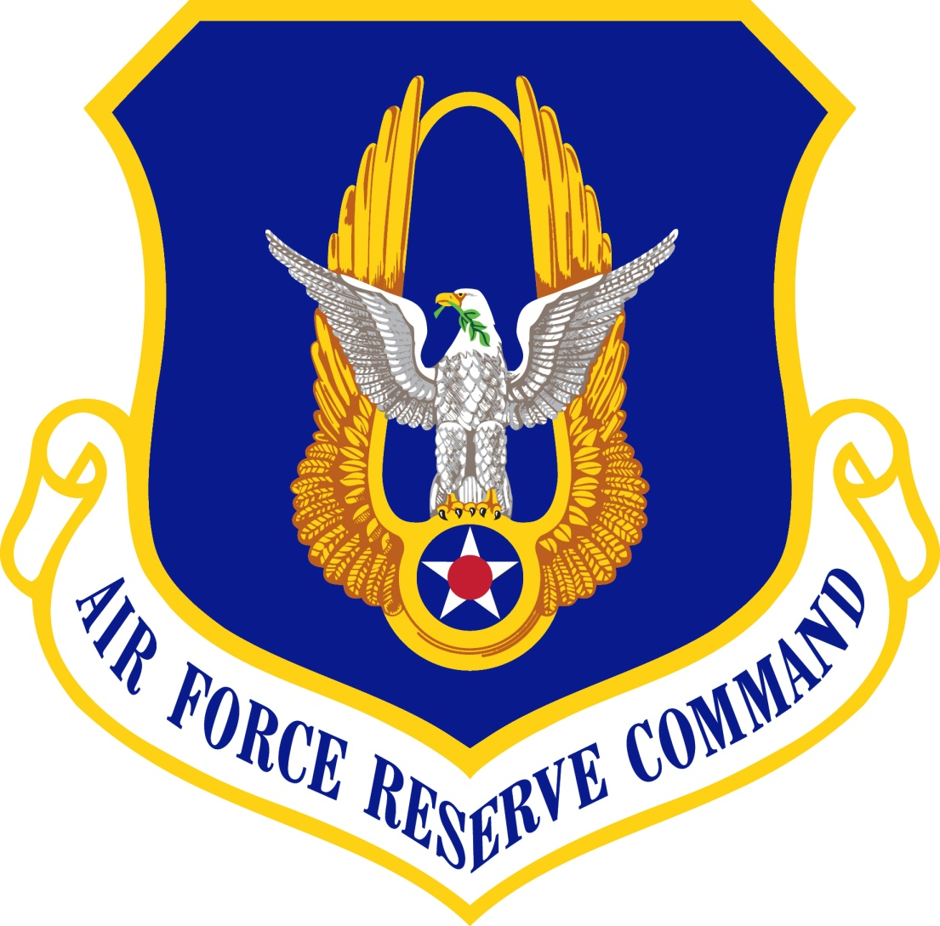
Questions?
Notes:
Slide POC: A7P
Updated: 26 May 13 (no changes)

Slide 17
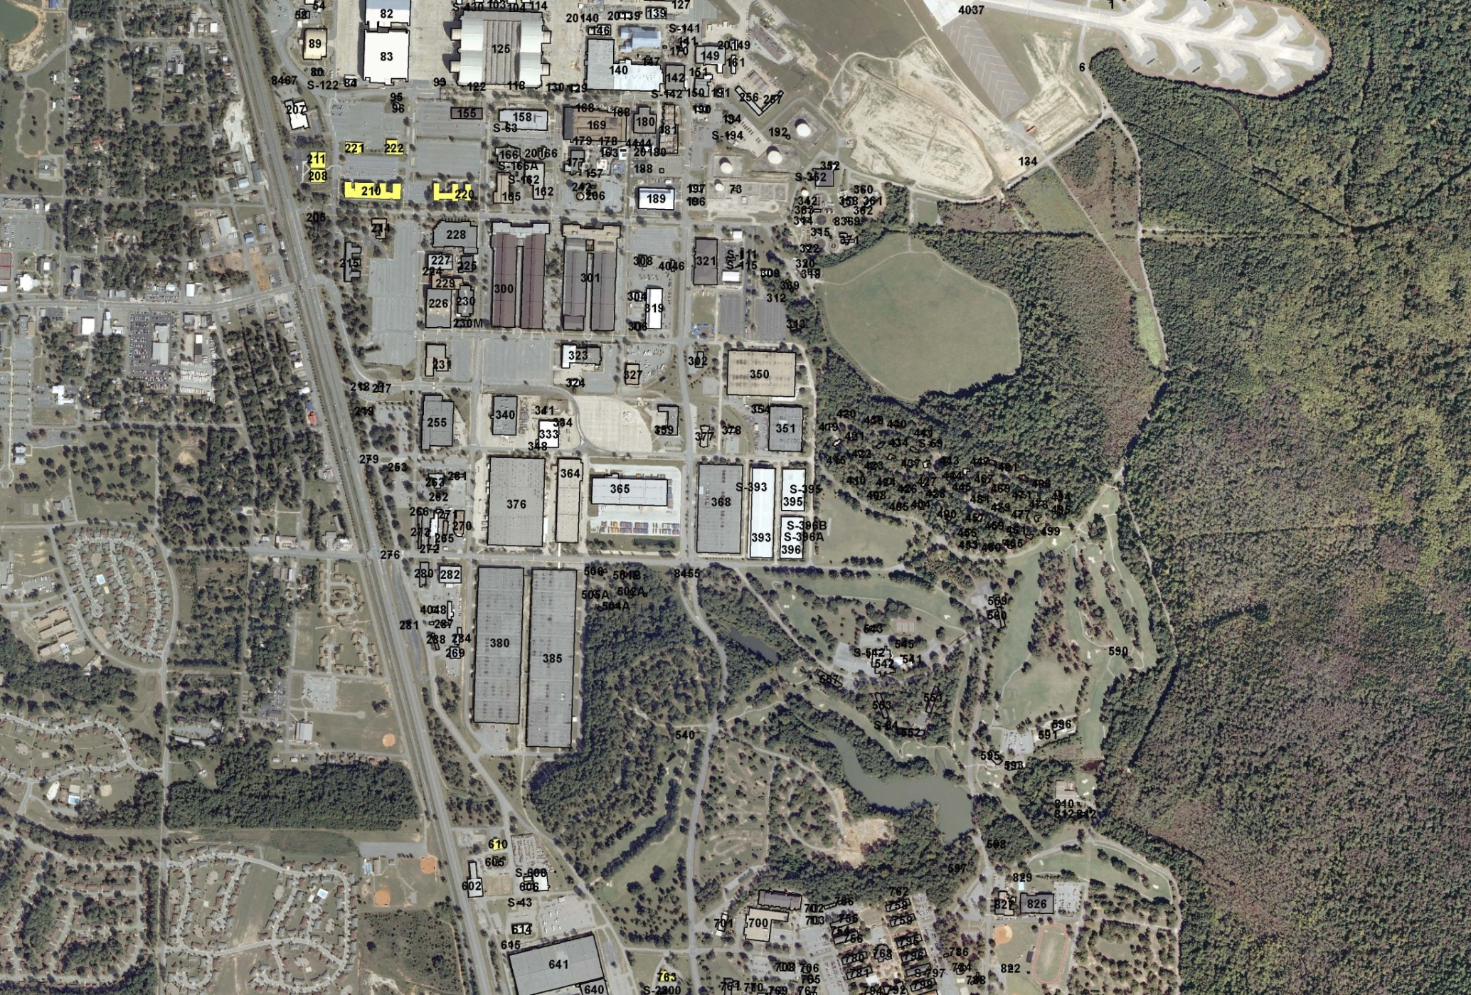
AFRC Consolidated Mission Complex Master Plan
Step 3: Consolidate personnel
within AFRC facilities
Status: Completed Mar 14
Industrial/Flightline Operations
Current AFRC Area
Benefits of the Plan
Effectively/efficiently meets AF, AFMC, AFRC needs
AFRC Consolidated Mission Complex, Ph 1 MILCON is 1st step in moving out of temp leased facility; catalyst to AFMC consolidation plans
Consolidates up to 9 facilities into 1
Saves WR-ALC estimated $39M MILCON by reusing vacated facilities
AFMC/AFRC consolidation enables 14 facility, 149K Sq Ft demolition and 93K Sq Ft lease divestiture opportunities
Addresses AF 20/20 by 2020 footprint reduction requirements
Step 2: Move A4, A7, RMG
to Temporary HQ AFRC
Status: Completed Jun 12
Step 4: Move off-base personnel on-base, terminate off-base lease
Status: Completed Feb 13
Step 1: Construct Temp HQ AFRC
Status: Completed May 12
AFRC Deployment Readiness and Training Center
Status: Completed Jan 13
Public Affairs moved in Feb 13
Base Admin Area
Steps 5, 6, and 7: Construct and
relocate to AFRC Consolidated Mission Complex in 3 phases via MILCON
Current AFRC Facilities
Avoids up to $39M MILCON; “win-win” consolidation for two MAJCOMs; demolish worst, energy hog facilities
Notes:
OPR: A7P
Updated
We are following DoD direction to downsize HQs & will reduce our planned facility size appropriately, avoiding up to $37M of cost
- “Win-win” for AFMC & AFRC
-- Reduces AFMC MILCON $34M for SF & SC consolidation into AFRC vacated facilities
-- Consolidate from 9 facilities to 1 was original goal
-- 9% facility space reduction “current footprint” to “Program of Record” (all 3 phases) while centralizing programs increased staff 4%
-- Program of Record at 343K SF is 17% below GSA standard of 253 GSF/person
-- AFMC/AFRC consolidation enables 14 facility, 149K Sq Ft demolition & removal of 93K Sq Ft on-base lease
- Plan is to absorb proposed HQ reductions in 3rd phase of facility & avoid approximately $37M MILCON…ultimately, the facility will be right-sized based on remaining HQs requirement
- New AFRC Complex FY15 PB Program of Record – 343.4K SF
-- Phase 1 – 93K SF, $27.7M (Replace temporary facility)
-- Phase 2 – 125.5K SF, $35.5M (not in AFRC FYDP = not visible to Congress)
-- Phase 3 – 125.9K SF, $37.0M (not in AFRC FYDP = not visible to Congress). Potential to eliminate need for the third phase due to HQ manpower reductions &/or leaving some staff in existing facilities…will finalize once HQ reductions known)
- Projected energy savings if all phases of new facility & 149K SF demolition is $153K/yr
- Temp facility lease cost: beyond 5th year (2017), estimate ~$1.5M per year or less similar to year 4-5 lease payment ($1.8M).
- OMB Freeze the Footprint Guidance: Directs agencies to cap domestic owned & leased office & warehouse space footprint to FY12 baseline. AFRC analysis indicates we have a net reduction in admin space FY13-17
-- Admin Space: reduced 4%
-- Warehouse Space: 0%

Slide 18
AFRC CMC Master Plan Update Site Plan
Ph 1: Cmd Staff, A1, A5/8, FM
Ph 2: A2, A3, A6, 24/7
Ph 3: A4/7, A9, special staff
Highlights
Ties in new FGC
Heritage plaza
Historical
Host ceremonies
Eating, Sitting, Relaxing areas
Distributed parking
Each phase: site looks complete
Simple, natural landscaping
Covered walkways
Tie to fitness trails
AT/FP compliant
North
3
1
FGC
2
Vision: “Create a timeless, synergistic Consolidated Mission Complex that promotes the proud heritage of AFRC's professional Citizen Airmen providing cost effective combat power for America.”
2 May 14
AFRC/A7P
Notes:
OPR: A7P
Updated

